Slide 1
Android sweatshop II
7.7.16

Slide 2
Last episode
Activity lifecycle
Logcat
Layouts
MATCH_PARENT vs WRAP_CONTENT
Views
OnClickListener

Slide 3
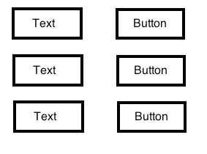
Home work
A client asked for a grid like app, each TextView should hold a separate counter
Bonus - use three horizontal LinearLayout for each row, and a vertical LinearLayout for their parent

Slide 4
Home work
Challenge - how to align them ?
Hint: LinearLayout + LinearLayouts
Any one wanna try ?

Slide 5
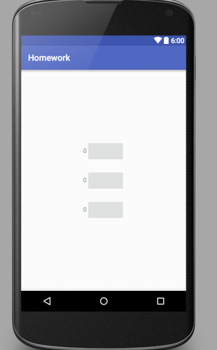
Home work UI

Slide 6
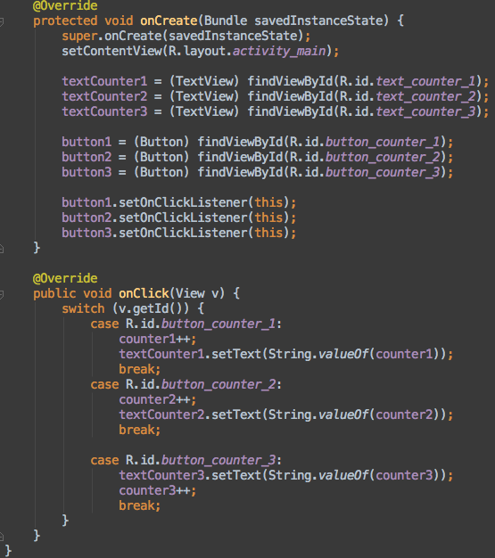
Homework solution

Slide 7
Home work activity_main.xml
RelativeLayout (why?)
LinearLayout
LinearLayout
TextView
Button
LinearLayout
TextView
Button
LinearLayout
TextView
Button

Slide 8
Content table
Pizza app (from Android For Dummies)
More views and layouts
Bitamp
Passing data to another activity
Intent
TODO app
ListView
Array adapter

Slide 9
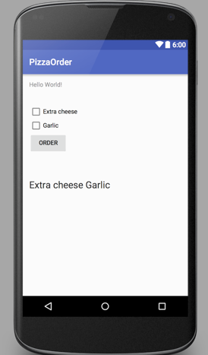
PIZZA !

Slide 10
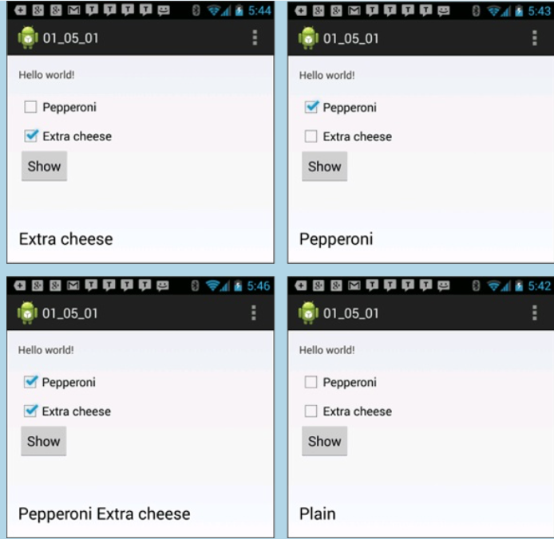
More examples

Slide 11
PIZZA - what does it do ?
Press on Order
Check which checkboxes are press
Set the order string inside the textview

Slide 12
Pizza instructions - layout designer
Drag checkboxes
Drag buttons
Drag a large TextView
Remove the HelloWorld
Change the id’s to match

Slide 13
PIZZA - MainActivity
add Class members - all of the views
private CheckBox …
set them using findViewById(R.id.view_id)
garlicCheckBox = findByViewId…

Slide 14
MainActivity - onClickListener
Set our Order button OnClickListener
Check checkboxes ;)
Update string

Slide 15
Improvements

Slide 16
TODO app

Slide 17
TODO lists are useful
We’re gonna learn more about Android UI
Activities and intents
Later: fragments, action bars, preferences, sql

Slide 18
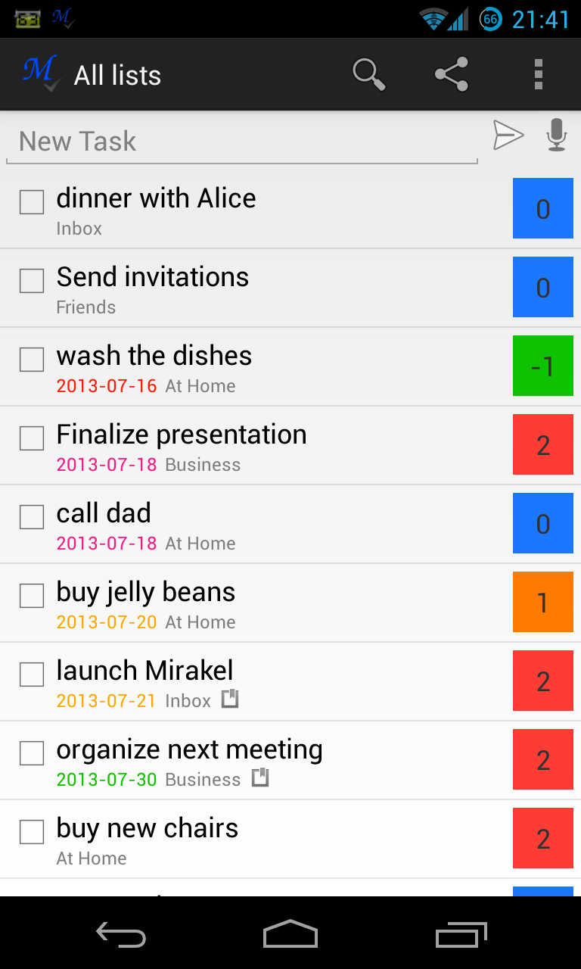
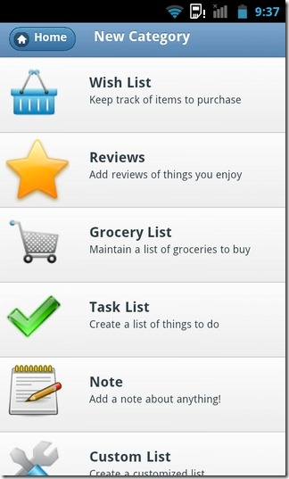
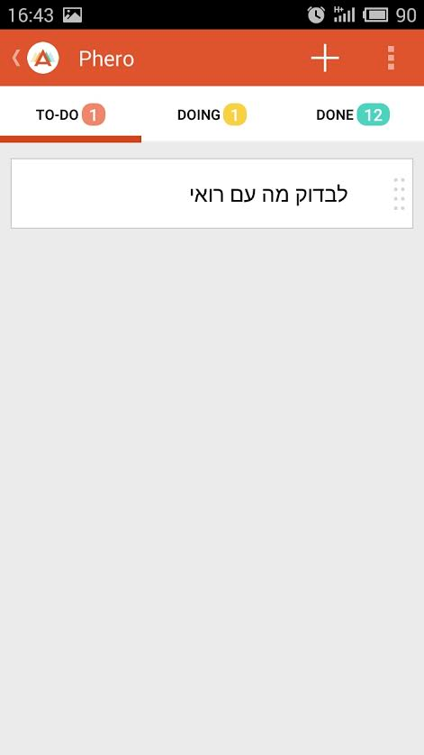
simple

Slide 19
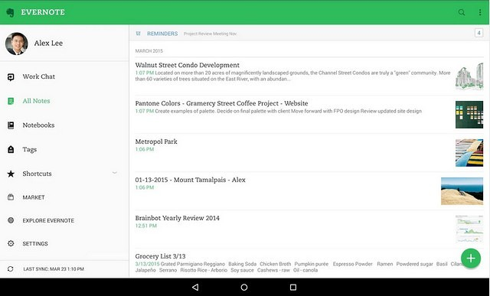
Complex

Slide 20
NoteListActivity
Design the layout
ListView
Add TODO item button
notify the adapter list changed
Later: onClick() of item starts EditActivity

Slide 21
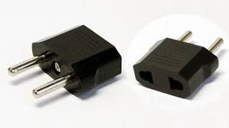
Adapter class as an Android design pattern
The Adapter pattern allows two incompatible classes to work together by converting the interface of one class into an interface expected by the clients.

Slide 22
Coding time !
Start with NoteListActivity

Slide 23
How do we add the content of the note ?
We need another activity !

Slide 24
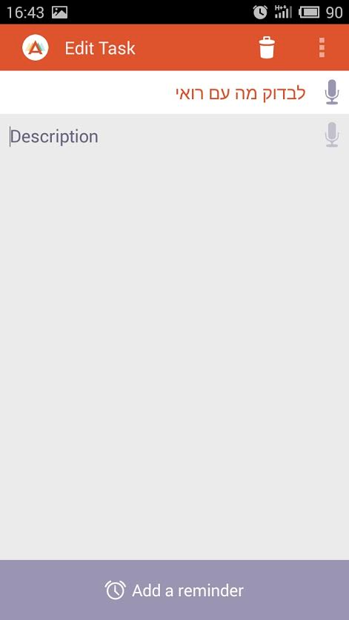
EditNoteActivity
Title of note
Body content
Edit button

Slide 25
Starting another activity
How do we move from screen to screen ?

Slide 26
Intent - special Android component
The most common use of intents is to bind your application components. Intents are used to start, stop and transition the activities within an application.

Slide 27

Of course we can add variables to this intent

Slide 28
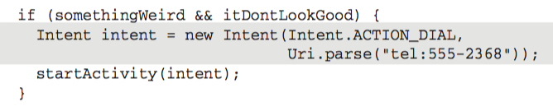

Slide 29


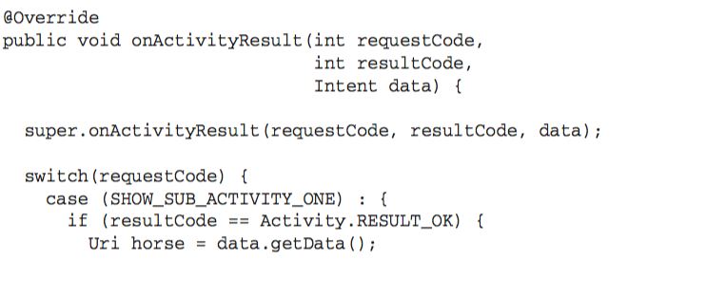
Returning results from activity
receive on the activity end

Slide 30
Practice
Start EditNoteActivity with the intent as in the example
Explicit intent
startActivityForResult(intent)
add to it a test string “test” (putExtra)
Add an edit box and a go back button and return the result back the NoteActivity
set OnClickListener for the go back button
init a new Intent
setResult(intent)
finish

Slide 31
What’s left for the note?
Long click on a note to delete
Dialog Interface
Saving the data

Slide 32
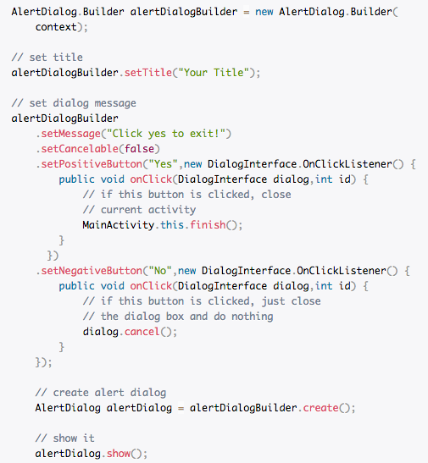
Alert dialog

Slide 33
Practice
Start a dialog on a long click of the item list view, it should ask either to delete it or not. On delete, delete.

Slide 34
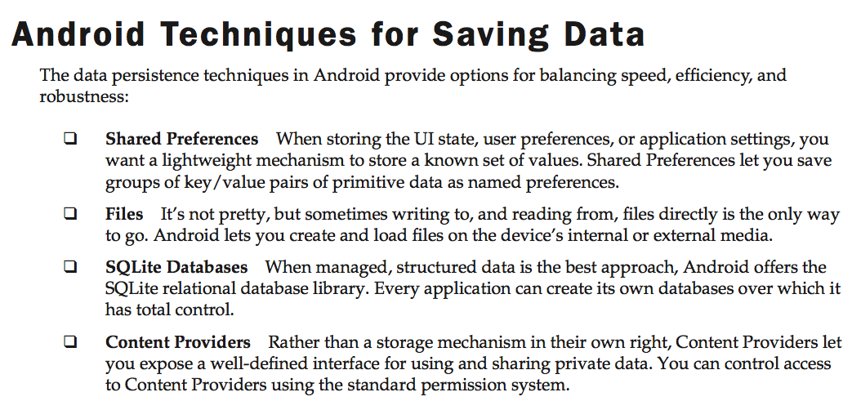

Slide 35

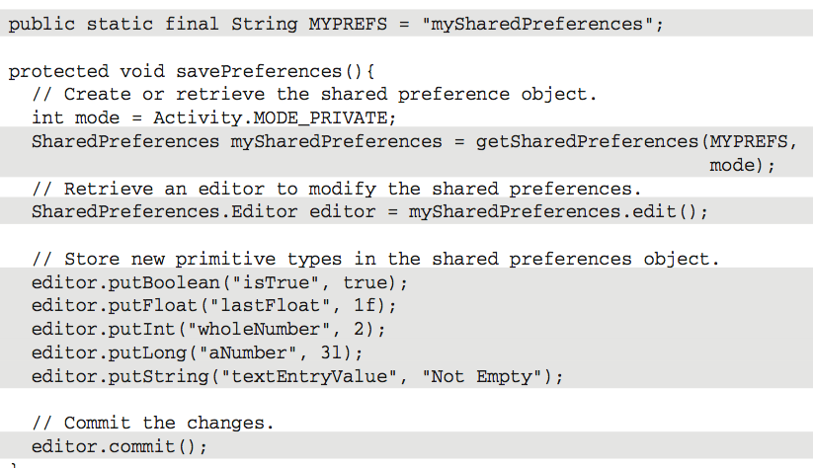

Slide 36
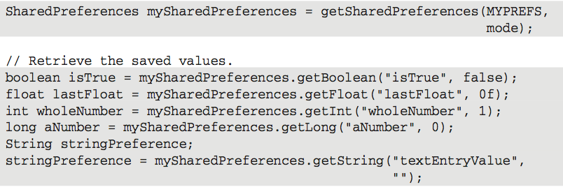

Slide 37
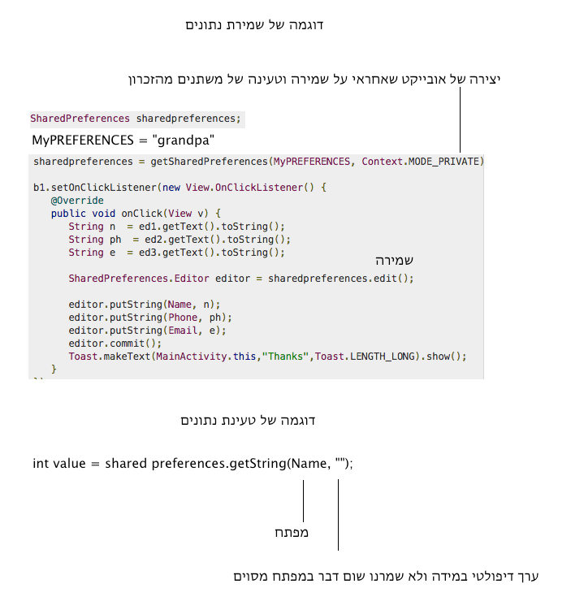

Slide 38
Practice
Create a shared preferences
Save a string
Save all title notes
Save all note details

Slide 39
Homework

